Slide 1








PathogenSurveillance An automated pipeline for population genomic analysis of pathogens
Zachary S. L. Foster¹, Martha Sudermann², Camilo Parada-Rojas², Logan K. Blair¹, Fernanda Iruegas-Bocardo², Alexandra J Weisberg², Jeff H. Chang², and Niklaus J. Grünwald¹
¹ Horticultural Crops Disease and Pest Management Research Unit, USDA Agricultural Research Service, Corvallis, OR
² Department of Botany and Plant Pathology, Oregon State University, Corvallis, OR
USDA ARS FNRI, NPDRS, NNCRC
OAN, ODA, ODF
J. Frank Schmidt

Slide 2
Apologies
Our lead developer Zach Foster could not come
Pipeline will be by demo only
But we are planning to hold a web-based workshop in a few months

Slide 3
Start demo run
> nextflow run nf-core/pathogensurveillance -profile singularity,test_bacteria -resume --outdir test_output -c nextflow_profiles/cqls.config -r master

Slide 4
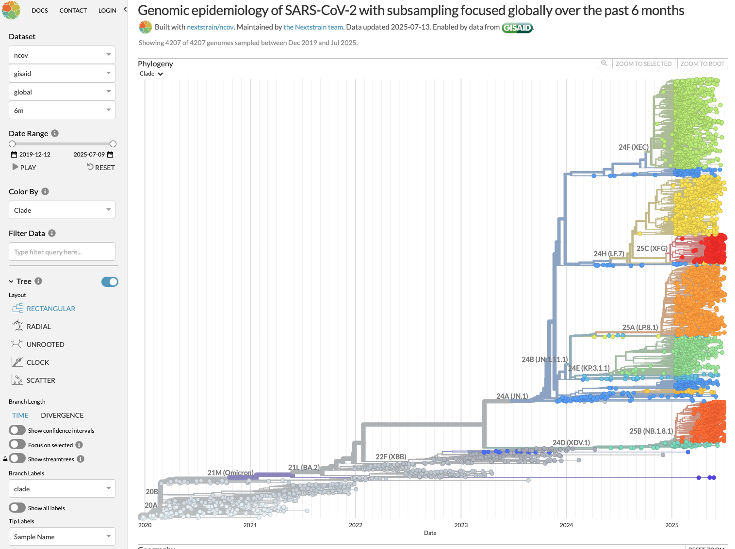
COVID19 genotyping
https://nextstrain.org/ncov/gisaid/global/6m

Slide 5
COVID19 genotyping
Shortcomings
Built for viral genomes (e.g. COVID-19)
Haploid, small genomes only
We assembled mitochondrial genome
Custom snakemake pipeline with little flexibility
https://nextstrain.org/ncov/gisaid/global/6m

Slide 6

Biosurveillance of sudden oak death
We named lineages NA1, NA2, EU1 and EU2 for the continent on which they first invaded.
We documented three invasions into US forests and nurseries.
Standard nomenclature and tracing of pathogen helps Forest Service, USDA APHIS, California Department of Food and Ag, Oregon State Department of Ag, Oregon State Department of Forestry conduct targeted management of SOD.

Slide 7
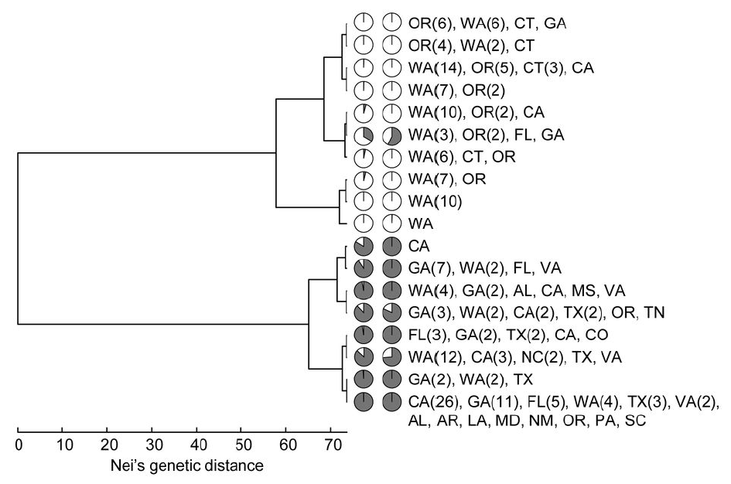
Two major migration pathways:
PLoS Pathogens (2009) 5, e1000583

Slide 8
5 migrations
Trends in Microbiology (2012); Van Poucke et al. 2012

Slide 9
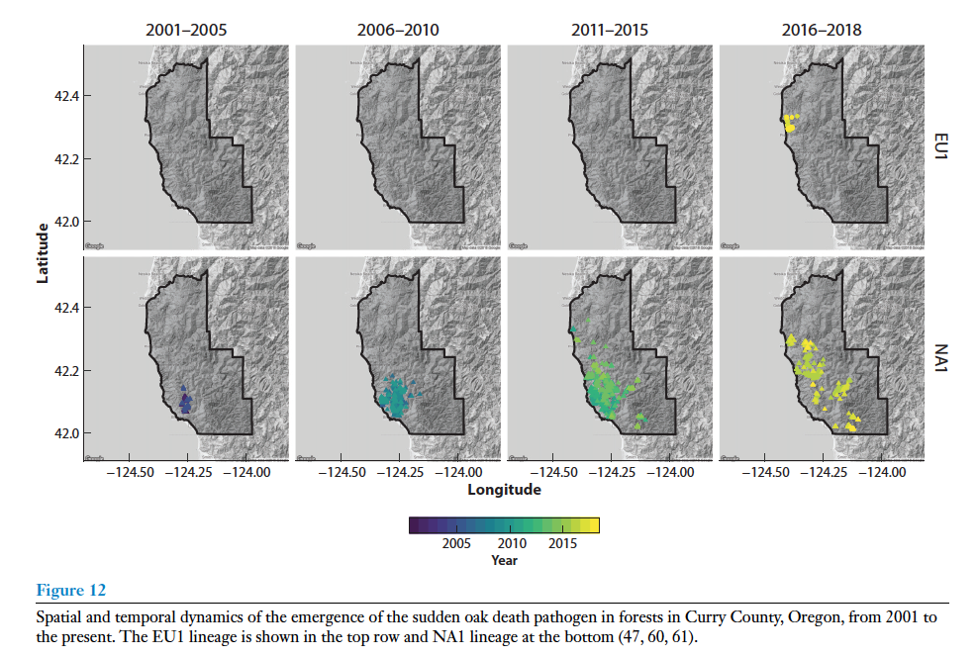
New invasion
EU1
NA1

Slide 10
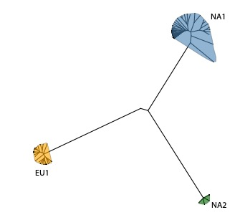
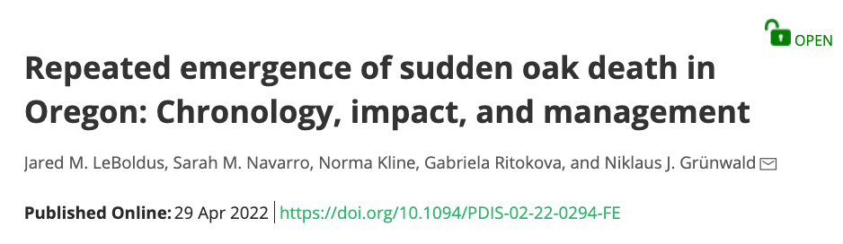
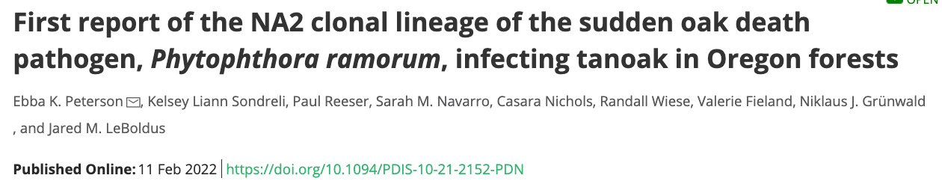
Oregon Forest: ~2001, 2015, 2021 invasions
Evidence for at least 4 introductions

Slide 11

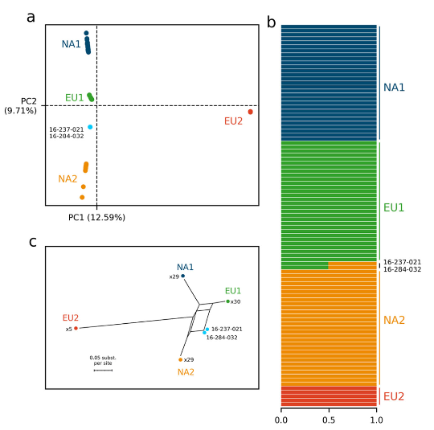
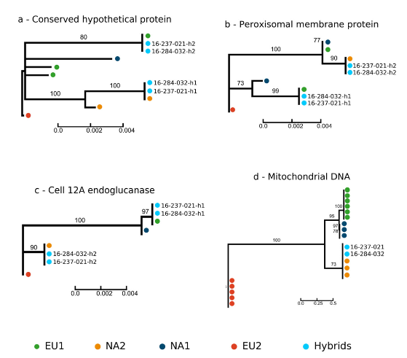
Detection of first sexual variants

Slide 12
Continued emergence of sexual variants

Slide 13

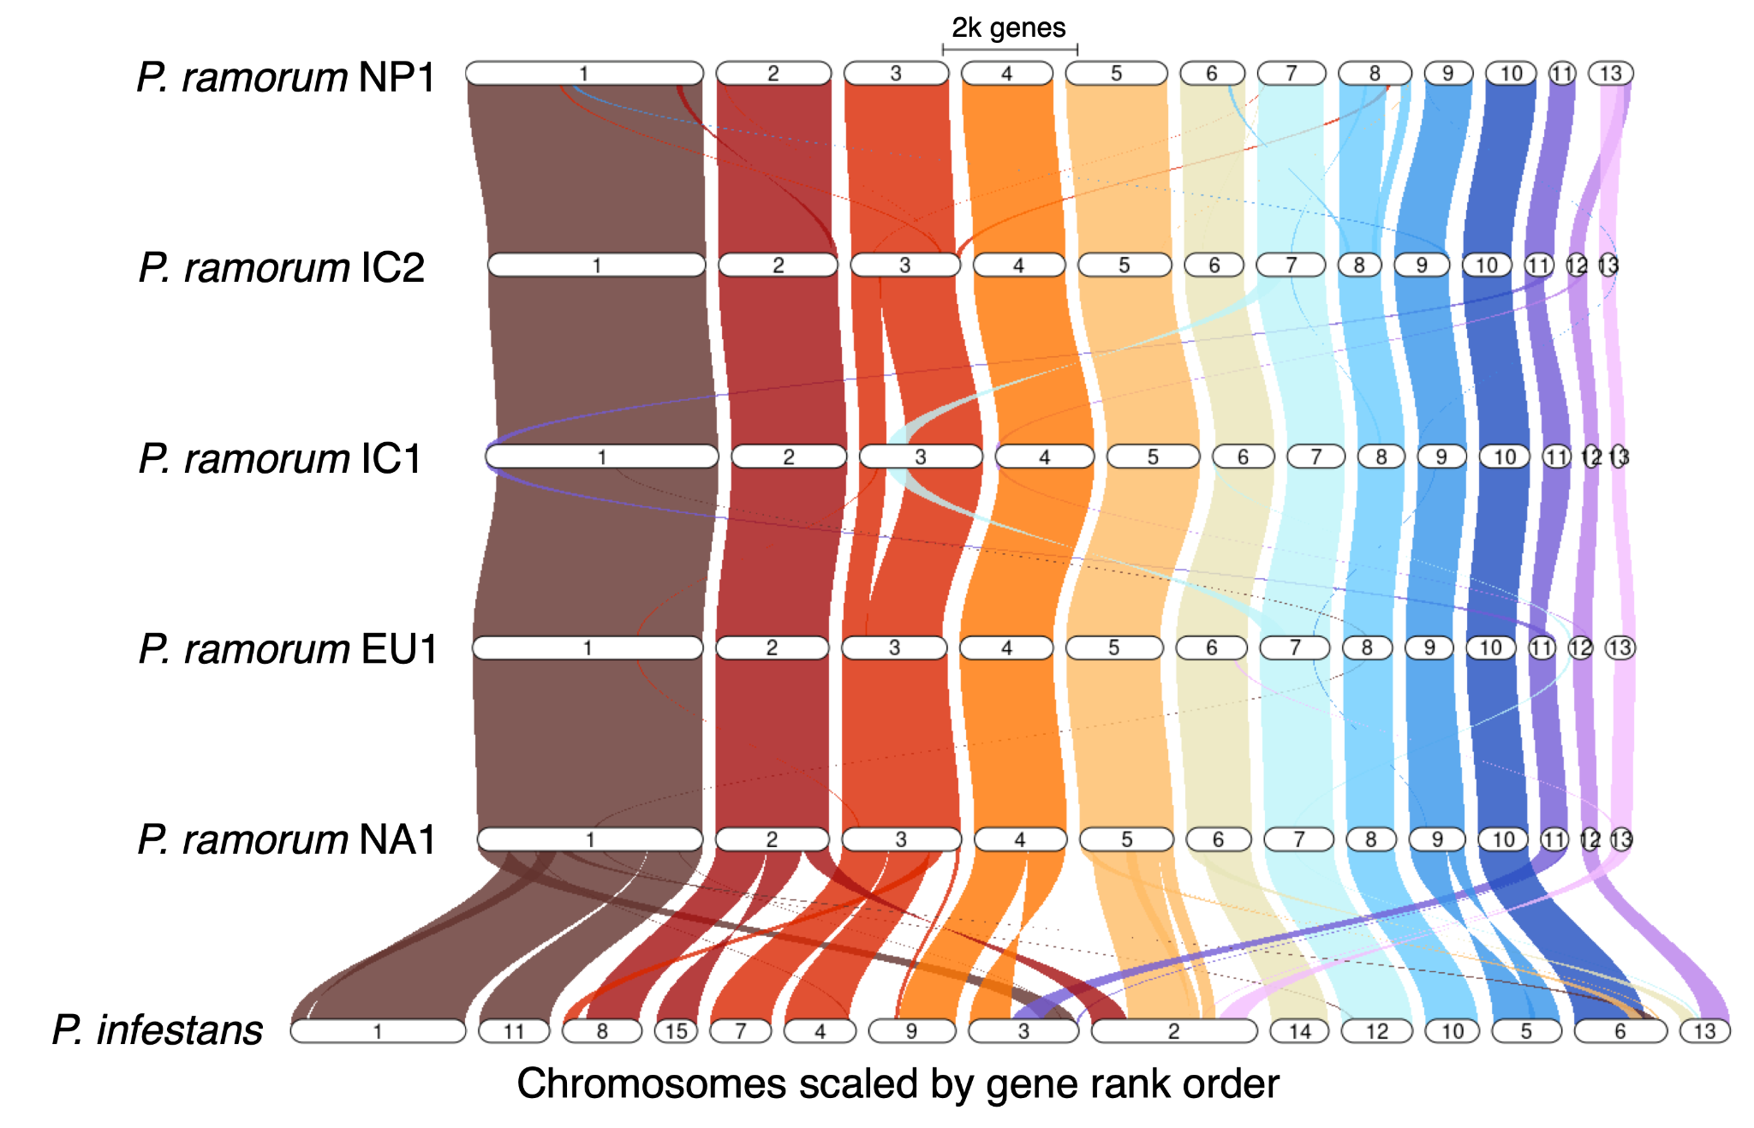
Five PacBio genomes are highly syntenic
Nick Cauldron
Matson et al. 2022

Slide 14
Need for a computational pipeline for real-time whole genome sequencing and analysis
Advantages:
Rapid ID of species (known or unknown), variants, clonal lineages, etc.
Genes of interest:
Effectors
Pesticide/antimicrobial resistance
Mating type
Toxins
Permanent digital archive
Provides evolutionary history
Is now affordable with decreasing sequencing costs ca. $10-50 per sample
But:
Computational analysis is currently slow and iterative
Requires substantial expertise and cloud access
Thus:
We need an automated workflow

Slide 15
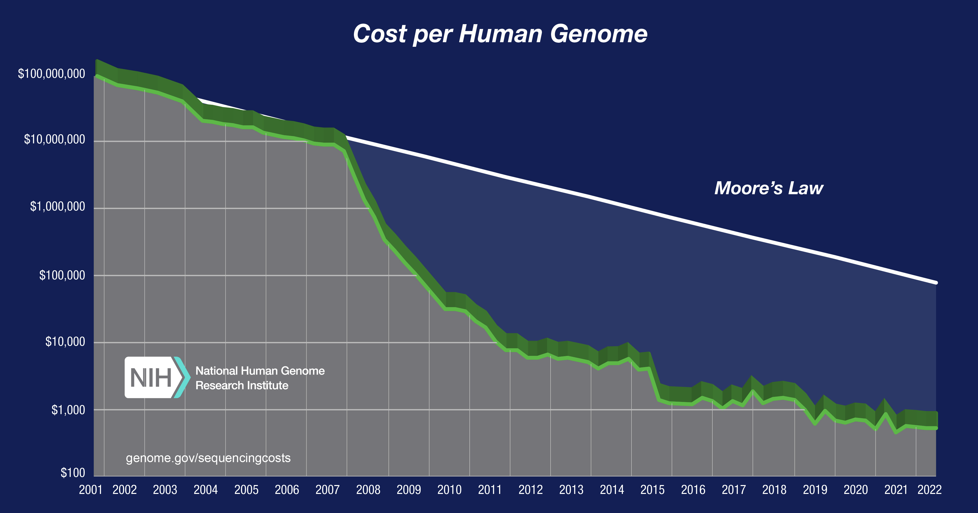

Slide 16
Pathogen Surveillance pipeline
Objective: To identify a pathogen sample or a population of samples using whole genome sequences to species if known or taxonomic placement if unknown
Characteristics of pipeline:
Automated, minimal input and standard diagnostic output
Agnostic to pathogen species
Work on single or any mix of samples including populations
Identifies taxonomic placement
Shows genetic diversity to identify variants within species
Scalable, robust, reproducible, and portable

Slide 17
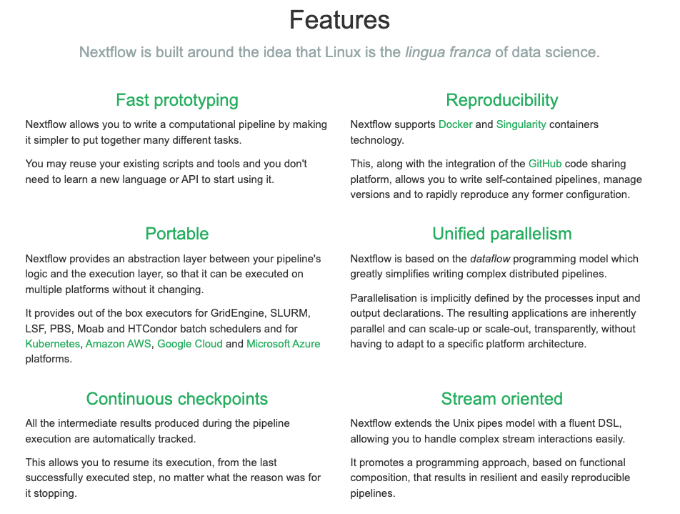
Nextflow
strengths
Notes:
Distinct advantages:
Allows for fast prototyping
Reproducible across all environments using containers such as docker
Portable to any linux cloud including SCInet. In fact, we are currently evaluating runs on SCInet with USDA Area postdoc Logan Blair.
Can be run with any number of samples.

Slide 18
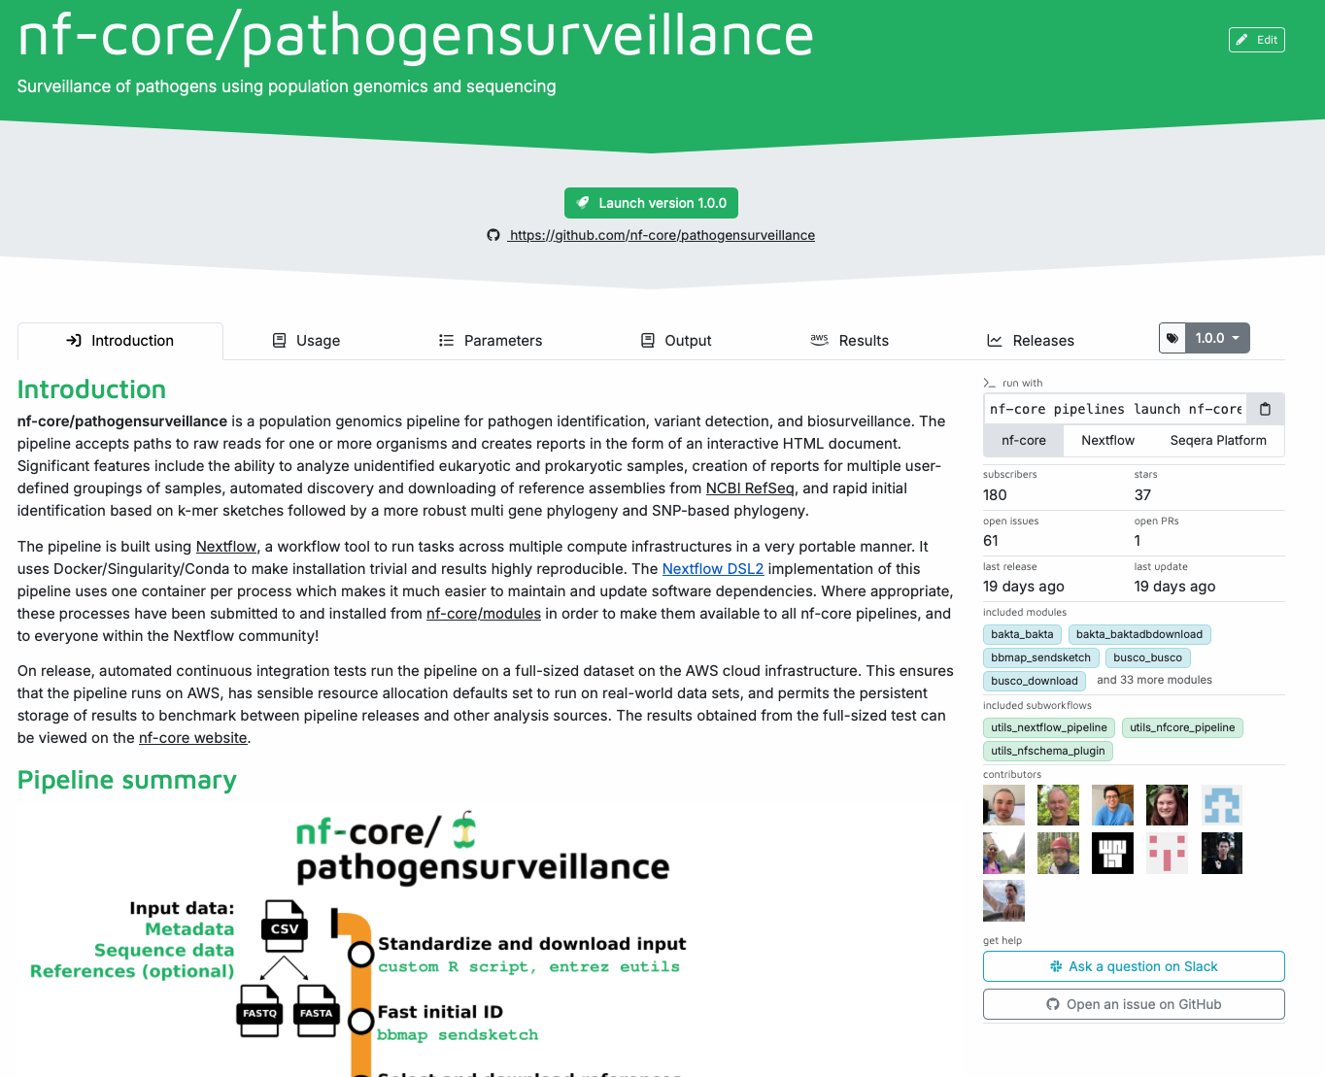

Slide 20
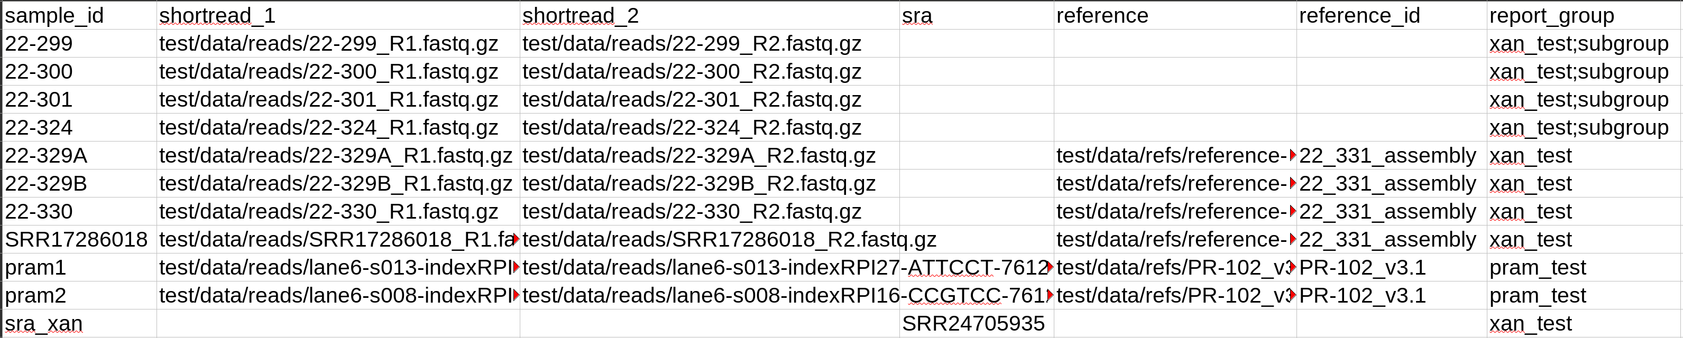
Input for PathogenSurveillance
CSV table w/ paths to input files (Illumina, Nanopore, PacBio)
Paths can be local or URLs
Can be NCBI accession numbers
Only data column must be filled out

Slide 21
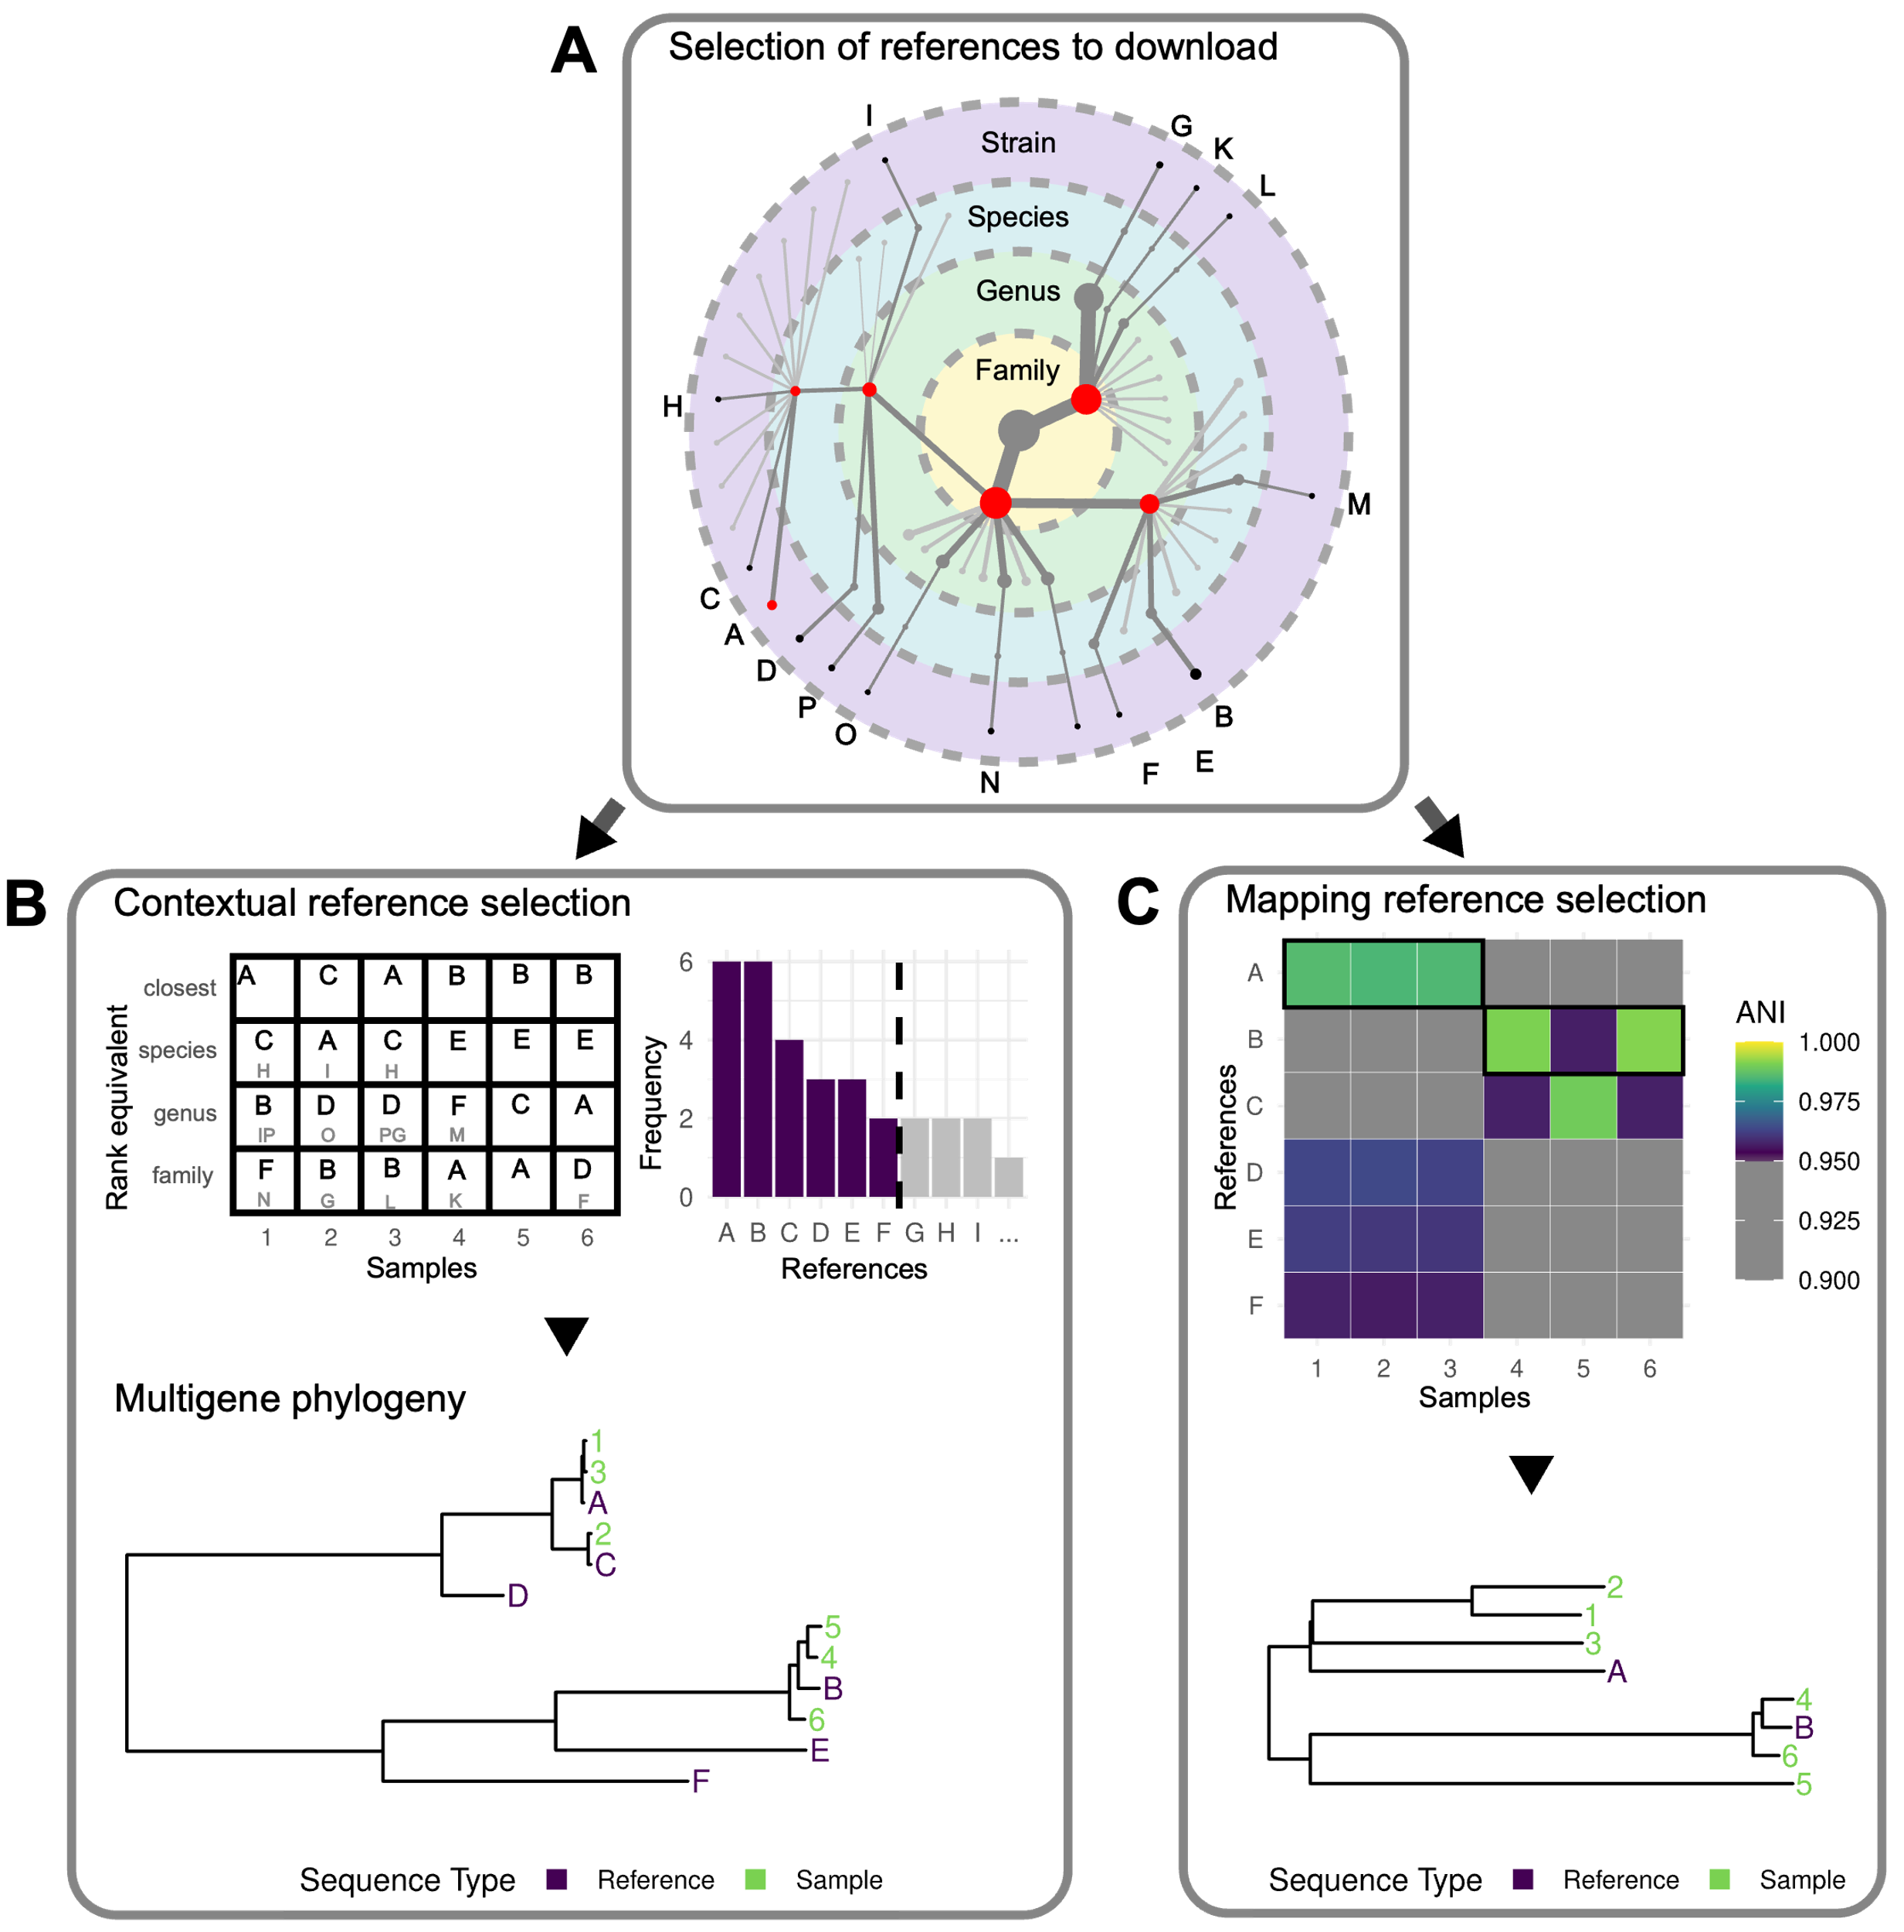
Automated reference selection
By default, automatically select and download reference genome sequences for any steps such as read mapping, multigene phylogeny inference and the SNP tree:
(A) Available genomes are downloaded for every family detected in any sample and a taxonomically representative subset of genomes are downloaded based on the initial identification of each sample.
(B) References for phylogenic comparisons are selected for each group of samples such that the minimum number of references are used that provide context for each taxonomic rank for each sample (approximated by ANI thresholds).
(C) References used to map reads and call variants are selected such that each sample has an ANI to at least one reference greater than a threshold (95% by default). References are chosen based on the number of samples have an ANI above this threshold and the mean ANI for all such samples. This ensures the minimum number of references is used, allowing for the most comparisons between samples.

Slide 22
Performance
Runtimes scale linearly with samples submitted for analyses
Max memory use also scales with sample size

Slide 23
Performance
Runtimes scale linearly with genome sizes
Note:
Prokaryotic and eukaryotic samples are handled differently in the pipeline
Prior to runs, read data was downloaded from NCBI and reads were subset to an estimate 25x coverage for prokaryotes and 50x for eukaryotes.

Slide 24
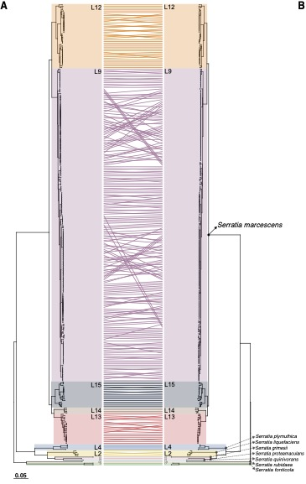
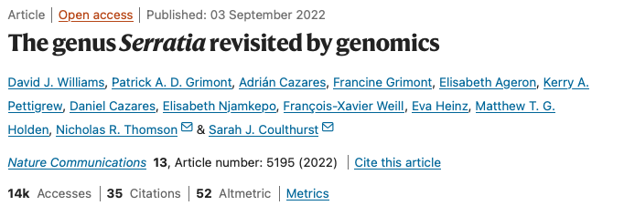
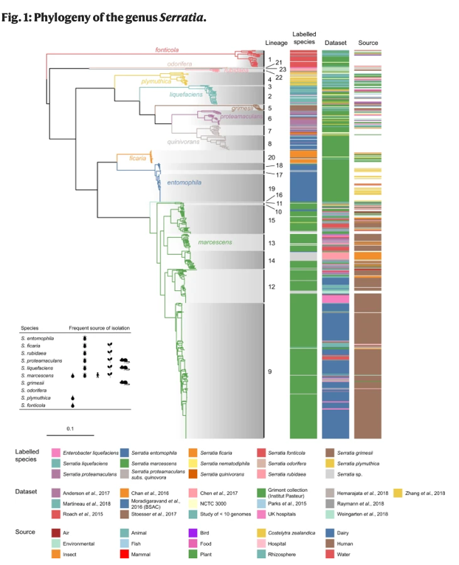
Proof of concept
Williams et al. (2022)
Pipeline results
Core gene phylogeny reproduced based on BUSCO genes
Complete concordance of lineage and species placements
1 command line statement run ~3 days days

Slide 25
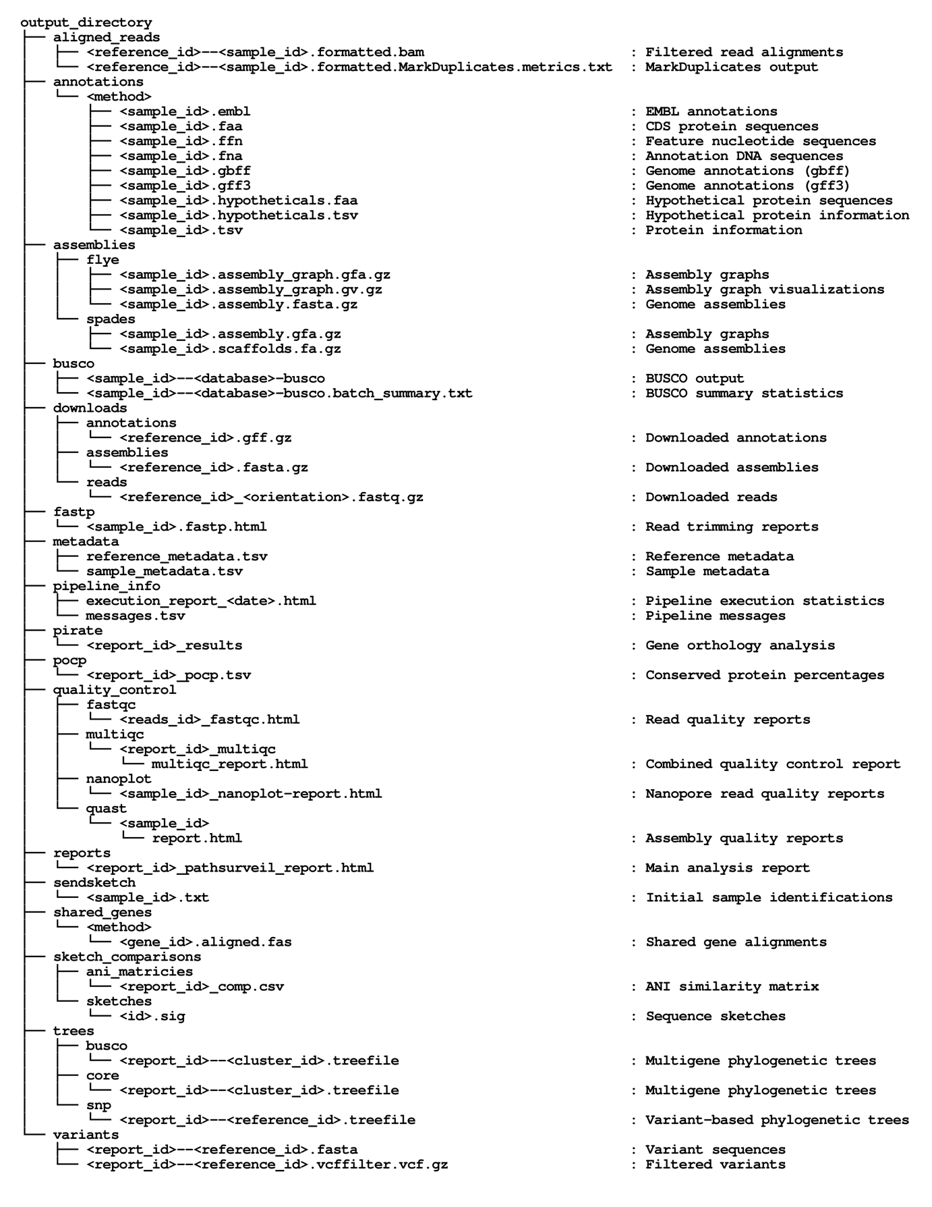
PathogenSurveillance can be used for further research
PathSurveilR companion R package used for mining output from PathogenSurveillance

Slide 26
Show nf-core/pathogensurveillance

Slide 27
Check and discuss demo run results
> nextflow run nf-core/pathogensurveillance -profile singularity,test_bacteria -resume --outdir test_output -c nextflow_profiles/cqls.config -r master

Slide 28
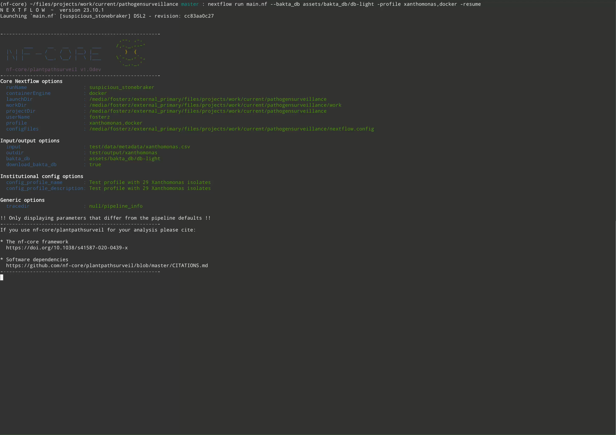
Example, cached run:

Slide 29
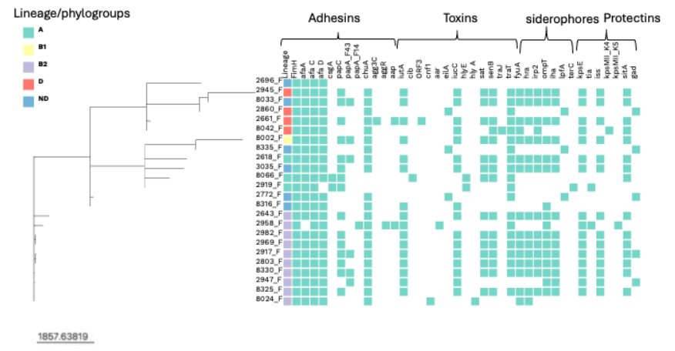
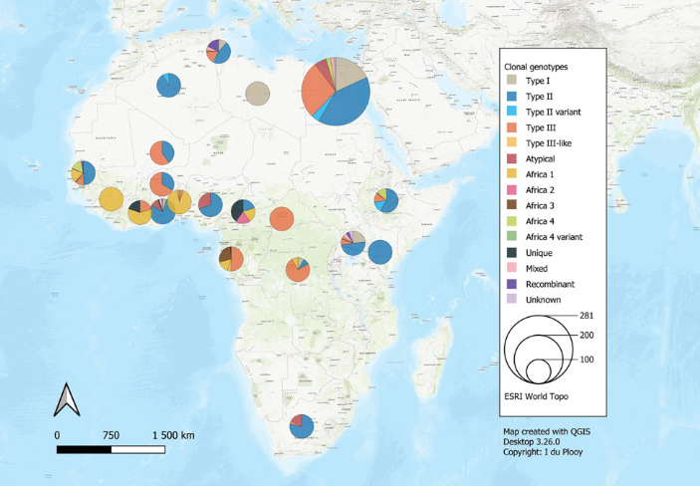
Future directions
Identify presence of genes of interest and visualize (e.g. molecular phenotyping)
Map samples with the location of similar organisms in public databases and create geolocation maps
Improve genome assembly and annotation of eukaryotes
Handle host DNA for more complex samples from infected tissue
Handle contaminated/metagenomic samples
Develop pathogen specific portals at species or genus levels
PathSurveilR R package

Slide 30
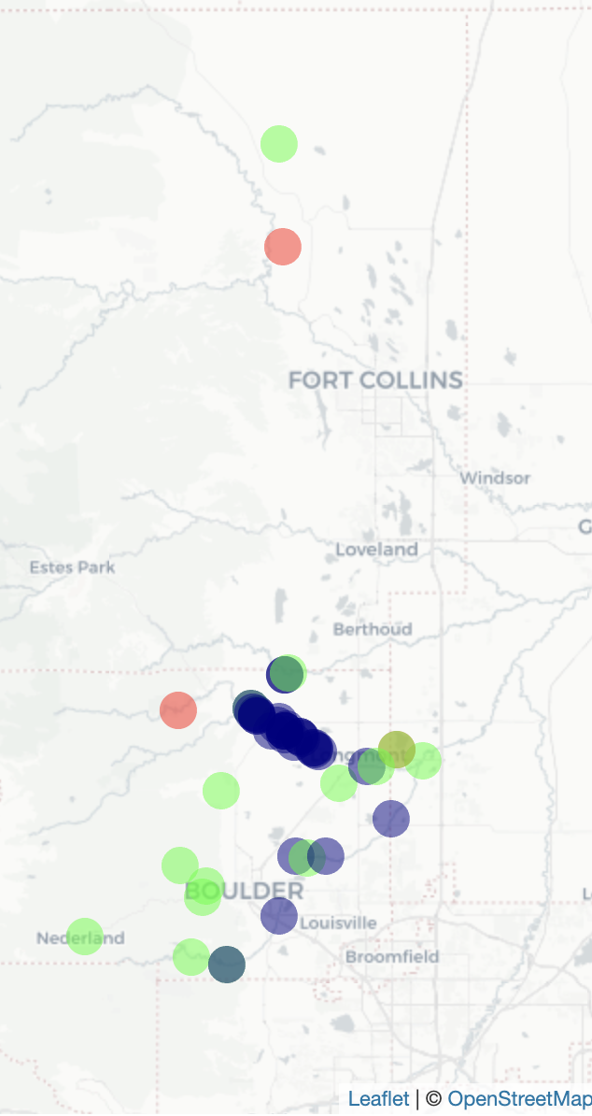
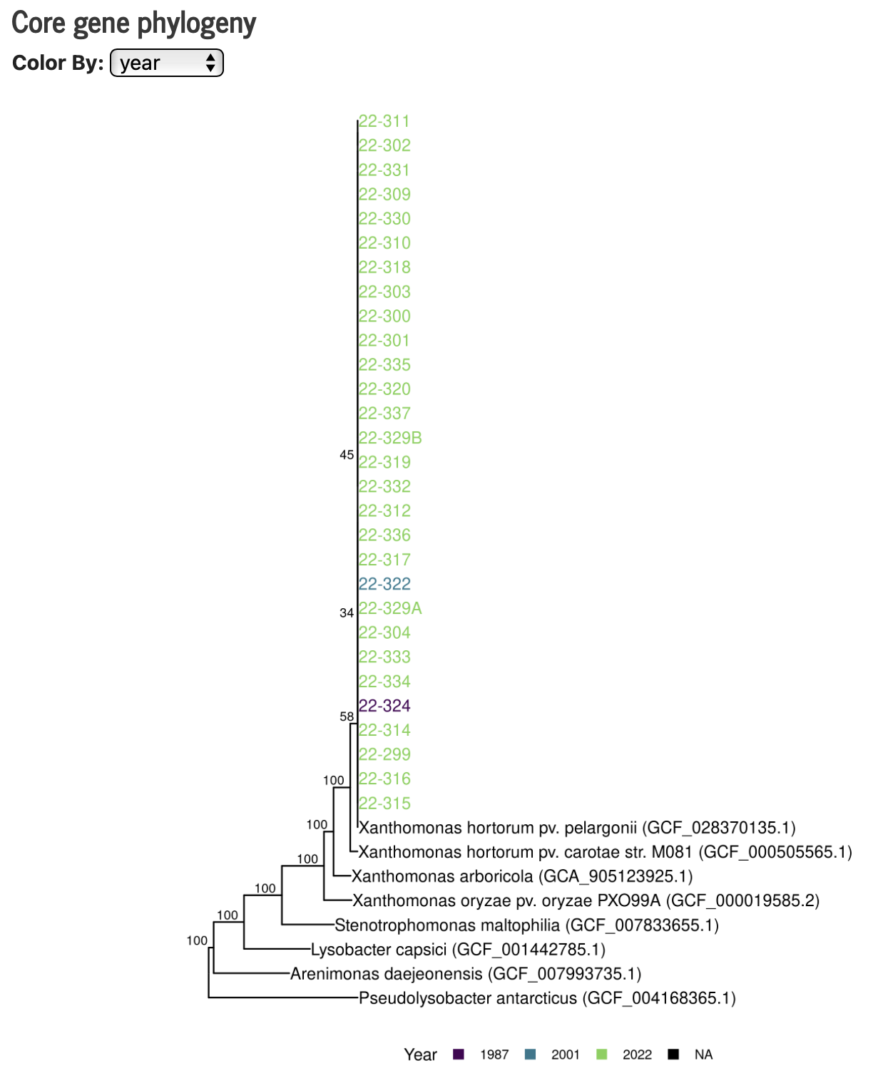
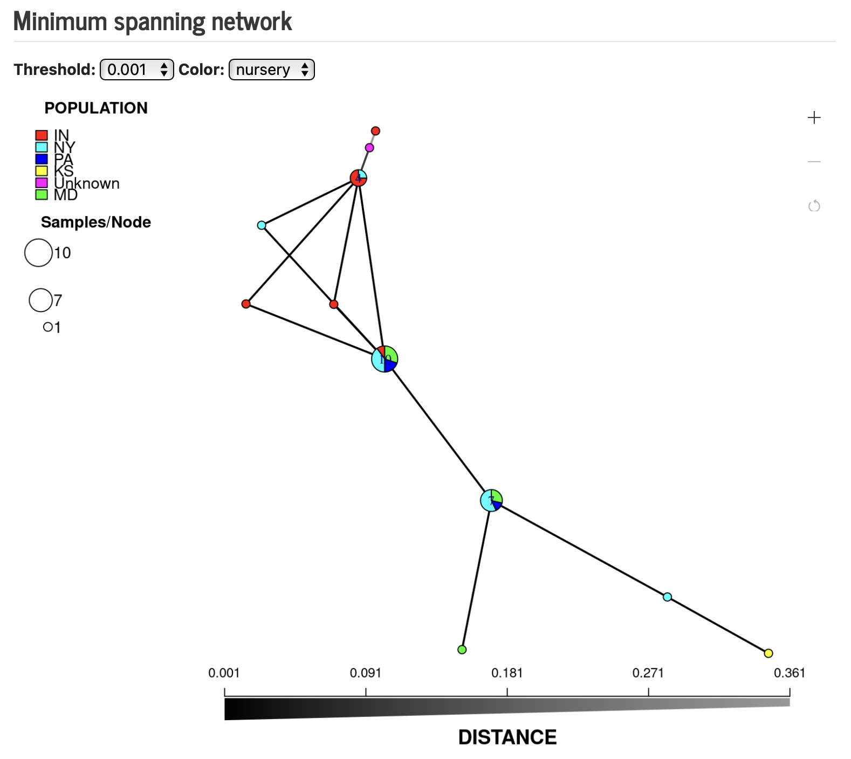
PS Dashboard: Xanthomonas hortorum
PathogenSurveillance pipeline status:
Report group: Xanthom. hortorum
Sample count: 29
Samples analyzed: 29
Samples discarded: 0
Last updated: September 27, 2024
Pipeline version: 0.1

Slide 31
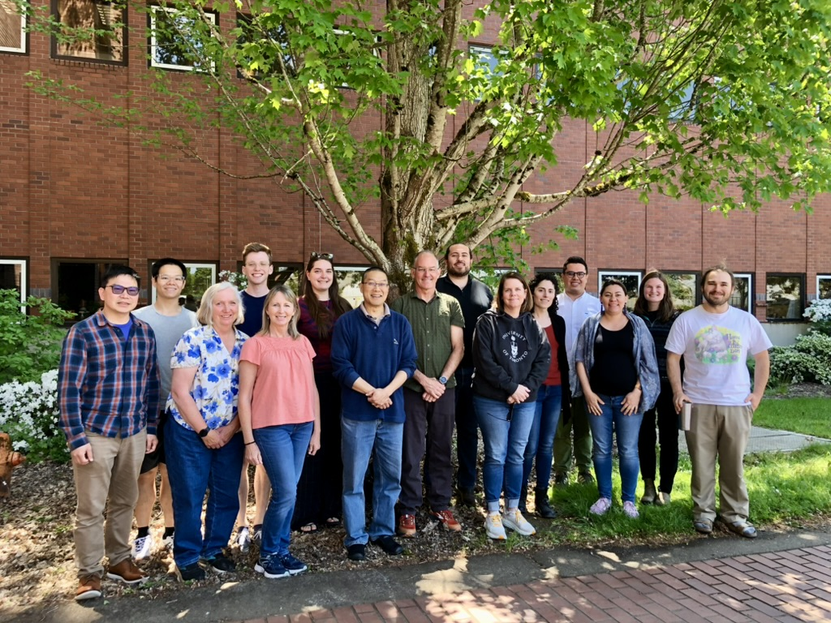




Collaborators:
Oregon State: Jeff Chang, Jared LeBoldus, Andy Jones, Alex Weisberg
USFS: Sarah Navarro
ARS: Frank Martin, Dave Gent
Virginia Tech: Boris Vinatzer, David Schmale, …
New Zealand: Rosie Bradshaw (Massie U), Rebecca McDougal (SCION), Nari Williams (Plant & Food)
Czech Republic: Thomas Jung (Mendel U)
UBC (Canada), ETH-WSL (Switzerland), Forest Research (UK)
ODA/OAN, ODF, CDFA, USFS, CDFA, APHIS
Grunwald lab:
Postdocs: Martha Sudermann (OSU), Camilo Parada-Rojas (OSU), Zach Foster (ARS), Logan Blair (ARS), Upasana Dhakal (OSU), Hayden Johnson (OSU), Andrew Tupper (OSU), Fernanda Iruegas-Bocardo (OSU), Ricardo Alcalá-Briseño (OSU), Alex Weisberg (OSU), Brian Knaus (ARS)
Students: Nick Cauldron (OSU, GS), Javier Tabima (OSU, GS), Zhian Kamvar (OSU, GS)
Technicians: Caroline Press (ARS), Val Fieland (OSU), Karan Fairchild (ARS)
Funding
USDA ARS FNRI, NWNRC & NPDRS
USDA APHIS, NIFA
CQLS, SCINet
OAN
HRI
ODA, ODF, CDFA
USFS PSW
J. Frank Schmidt

Slide 32

P-189 :Pathogensurveillance: An automated pipeline for population genomic analysis of pathogens
https://nf-co.re/pathogensurveillance/dev/

